Slide 1

Predictive Maintenance For synthetic milling software
Mamatha narri(u00347863) Ramya pogula(u00348972) Varshitha reddy kalluru(u00348587)
Team number: 13

Slide 2
INTRODUCTION
Predictive maintenance prevents unexpected breakdowns, ensuring continuous operation and reliability.
Utilizing data and patterns to foresee potential issues, avoiding unplanned disruptions and downtime.
Unlike traditional schedules, predictive maintenance optimizes machine care, reducing surprises and operational disruptions.
Modern technology enhances equipment care, saving money through proactive maintenance strategies.

Slide 3
MOTIVATION
Minimize Downtime and Repairs: Proactive maintenance predicts failures, reducing costly downtime and unplanned repairs.
Enhance Safety Through Early Warnings: Predictive models provide early warnings, preventing unexpected equipment failures and ensuring safety.
Improve Operational Efficiency: Timely maintenance schedules optimize operations, preventing flight cancellations and delays.
Cost Savings Through Proactive Maintenance: Identifying potential failures early minimizes costs, improving overall maintenance efficiency.

Slide 4
RELATED WORKS
Title: "Explainable AI in Manufacturing: A Predictive Maintenance Case Study"
Author: Bahrudin Hrnjica, Selver Softic
Summary: This case study reduces unplanned downtime by 40% using sensor data and machine learning, enhancing production efficiency.
Title: "Predictive maintenance analytics and implementation for aircraft: Challenges and opportunities"
Author: Izaak Stanton, Kamran Munir, Ahsan Ikram, Murad El-Bakry
Summary: This survey highlights the potential of predictive maintenance in aircraft, emphasizing the need for automation in the industry.

Slide 5
RELATED WORKS
Title: "How AI is Revolutionizing Wind Turbine Maintenance"
Author: Srividhya
Summary: The article discusses AI and drone applications for wind turbine maintenance, improving efficiency in wind energy production.
Title: "Optimal Preventive Maintenance of Wind Turbine Components with Imperfect Continuous Condition Monitoring"
Author: Ahmed Raza, Vladimir Ulansky
Summary: This article introduces a mathematical model for cost-effective preventive maintenance in wind turbines with continuous condition monitoring.

Slide 6
DATA SET
The dataset, available at this Kaggle link, offers a rich resource for predictive maintenance:
Link: https://www.kaggle.com/datasets/stephanmatzka/predictive-maintenance-dataset-ai4i-2020
Comprehensive Features: The dataset encompasses diverse milling data, including sensor readings, maintenance records, and environmental factors.
Realistic Representation: It provides a realistic portrayal of milling processes, essential for creating reliable synthetic data.
Historical Records: The dataset includes historical records of machine failures, flight hours, and past maintenance actions, enabling predictive modeling.
Data Variability: It captures variations in milling conditions, offering valuable insights for algorithm testing and validation.
Annotated Labels: The dataset is labeled to indicate machine failure, facilitating supervised machine learning model training and evaluation.

Slide 7
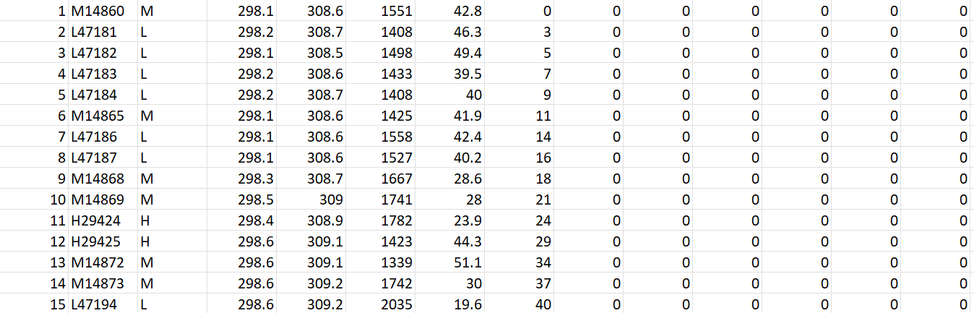
DATA SET

Slide 8
Static Analysis
Code Quality Review:
Objective: Assess code quality and readability.
Tools: Code linters, style checkers.
Benefits: Improves maintainability and reduces bugs.
Data Quality Assurance:
Objective: Ensure dataset integrity.
Tools: Data profiling, schema validation.
Benefits: Enhances model accuracy by addressing data quality.
Model Architecture Check:
Objective: Evaluate model structure.
Tools: Model diagrams, design documentation.
Benefits: Ensures a well-organized model implementation.
Security and Privacy Assessment:
Objective: Identify vulnerabilities.
Tools: Security scanners, code reviews.
Benefits: Mitigates risks of data breaches.
Compliance Check:
Objective: Ensure regulatory compliance.
Tools: Checklists, regulatory guidelines.
Benefits: Reduces legal and regulatory risks.

Slide 9
Dynamic Analysis
Model Performance Evaluation:
Objective: Assess predictive performance.
Metrics: Accuracy, precision, recall.
Benefits: Ensures model reliability.
Cross-Validation Testing:
Objective: Evaluate generalization.
Techniques: cross-validation.
Benefits: Validates robustness across datasets.
Real-time Model Monitoring:
Objective: Monitor performance in real-time.
Tools: Monitoring dashboards, alerts.
Benefits: Timely identification of performance issues.
Sensitivity Analysis:
Objective: Assess sensitivity to variable changes.
Techniques: One-variable-at-a-time analysis.
Benefits: Identifies critical variables.
Human-in-the-Loop Feedback Analysis:
Objective: Analyze user feedback.
Methods: Surveys, interviews.
Benefits: Aligns model with industry needs.

Slide 10
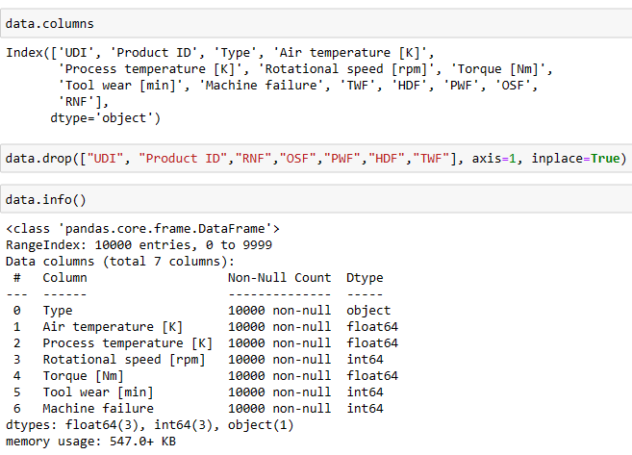
Data Cleaning
Checked for null values in dataset
No null values in dataset
Dropped columns 'UDI', 'Product ID', 'RNF', 'OSF', 'PWF', 'HDF', 'TWF' from the dataset using data.drop(["UDI", "Product ID","RNF","OSF","PWF","HDF","TWF"], axis=1, inplace=True).

Slide 11
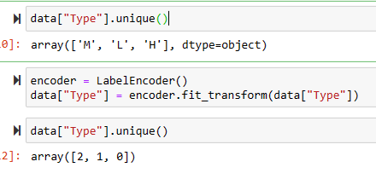
LABEL ENCODING
Transformed the 'Type' column from categorical values ('M', 'L', 'H') into numerical values (2, 1, 0), which is useful for machine learning models that require numerical input

Slide 12
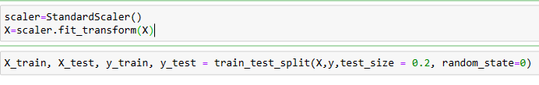
Data Scaling
Standard Scaling to your feature variables using StandardScaler
This standardizes the features to have a mean of 0 and a standard deviation of 1, which is important for some machine learning algorithms, especially those sensitive to the scale of input features.

Slide 13
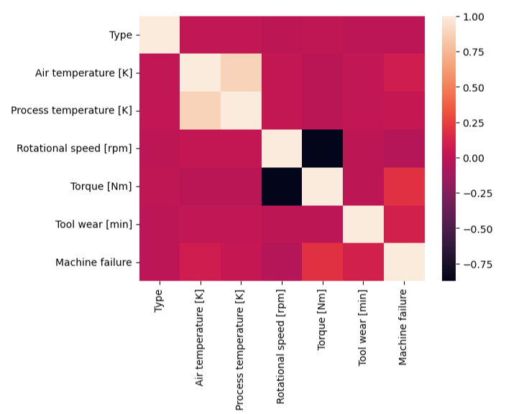
Correlation Heatmap

Slide 14
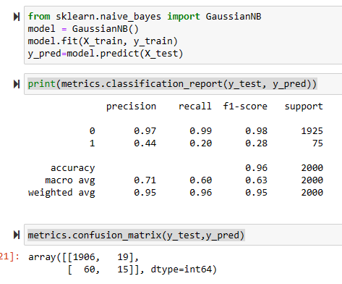
MODEL TRAINING - NAIVE BAYES CLASSIFIER
Precision: 0.44 (class 1), 0.97 (class 0)
Recall: 0.20 (class 1), 0.99 (class 0)
F1-Score: 0.28 (class 1), 0.98 (class 0)
Accuracy: 0.96

Slide 15
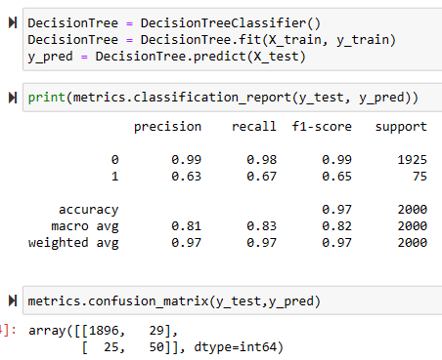
MODEL TRAINING - Decision Tree Classifier
Precision: 0.63 (class 1), 0.99 (class 0)
Recall: 0.67 (class 1), 0.98 (class 0)
F1-Score: 0.65 (class 1), 0.99 (class 0)
Accuracy: 0.97

Slide 16
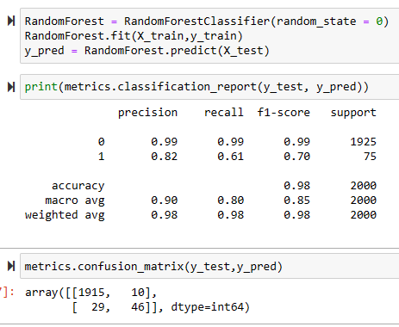
MODEL TRAINING - Random Forest Classifier
Precision: 0.82 (class 1), 0.99 (class 0)
Recall: 0.61 (class 1), 0.99 (class 0)
F1-Score: 0.70 (class 1), 0.99 (class 0)
Accuracy: 0.98

Slide 17
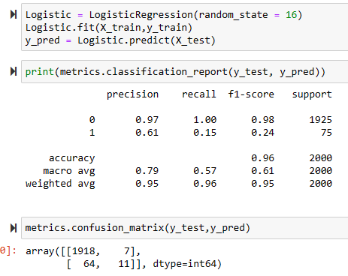
MODEL TRAINING – Logistic regression
Precision: 0.61 (class 1), 0.97 (class 0)
Recall: 0.15 (class 1), 1.00 (class 0)
F1-Score: 0.24 (class 1), 0.98 (class 0)
Accuracy: 0.96

Slide 18
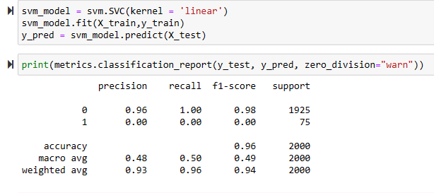
MODEL TRAINING - Support Vector Machine (SVM) Classifier
Precision: 0.00 (class 1), 0.96 (class 0)
Recall: 0.00 (class 1), 1.00 (class 0)
F1-Score: 0.00 (class 1), 0.98 (class 0)
Accuracy: 0.96

Slide 19
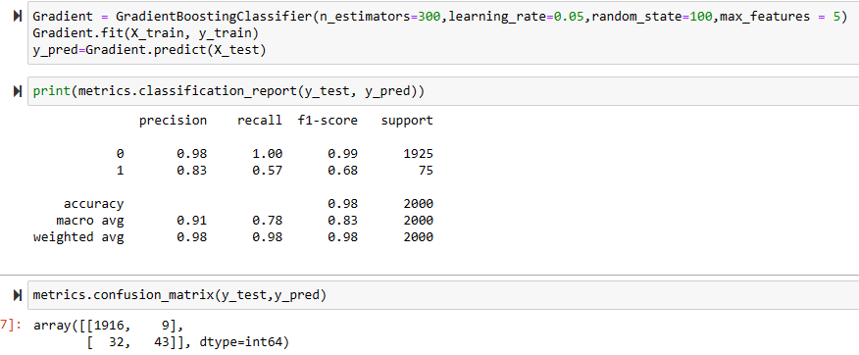
MODEL TRAINING - Gradient Boosting
Precision: 0.83 (class 1), 0.98 (class 0)
Recall: 0.57 (class 1), 1.00 (class 0)
F1-Score: 0.68 (class 1), 0.99 (class 0)
Accuracy: 0.98

Slide 20

Threats to Validity
Internal Validity: Confounding Variables
Threat: Factors not considered in the model (e.g., changes in operating conditions) could bias predictions.
Mitigation: Conduct sensitivity analyses, control for potential confounders, and ensure a thorough understanding of the milling process dynamics.
External Validity: Changes Over Time
Threat: Model effectiveness may diminish as relationships change.
Mitigation: Implement regular updates and retraining strategies; monitor for shifts in predictor-outcome relationships.

Slide 21
Threats to Validity
Conclusion Validity: Rigor and Trustworthiness Challenge
Mitigation: Rigor and trustworthiness are crucial for valid conclusions
Mitigation:
Ensure methodological rigor in study design.
Conduct thorough analyses to address internal threats.
Validate results across diverse datasets for external reliability.
Acknowledge and address any limitations transparently.
Construct Validity: Measurement Error
Threat: Inaccuracies in measuring key variables may impact model accuracy.
Mitigation: Implement rigorous data quality checks, validation protocols, and collaborate with domain experts to refine variable definitions.

Slide 22
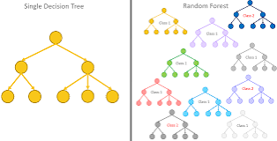
Research Question
Research Question:
How can the model's interpretability be enhanced to provide actionable insights for maintenance personnel in the milling industry?
Rationale:
Interpretability is crucial for the successful adoption of predictive maintenance models in industrial settings. Maintenance personnel need to understand the factors contributing to predictions, allowing them to make informed decisions. By focusing on interpretability, developers can ensure that the model's insights are transparent and actionable, fostering trust and usability in real-world scenarios.

Slide 23
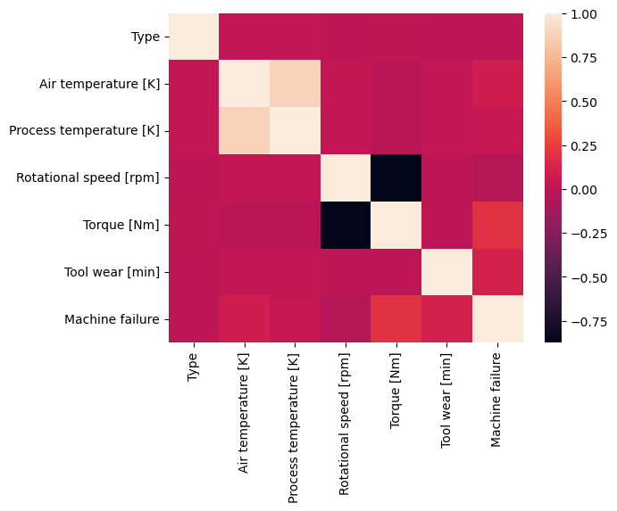
Research Question
Research Question:
How can the different features be related to each other, any features from data are having high correlation?
Rationale:
Correlation of different features are near, so no dependency on any features on each other

Slide 24
Research Question
Research Question:
Is Data balance in important in this type of dataset?
Rationale:
No, in real time for this kind of problem statement, balanced dataset will not work

Slide 25
CONCLUSION
Successful data cleaning and label encoding enhanced model interpretability and accuracy.
Feature selection improved model efficiency by removing redundant information.
Standardized scaling ensured fair model comparisons across different algorithms.
Diverse classifiers showcased varying trade-offs in precision and recall.
The Gradient Boosting model stood out with high accuracy.

Slide 26
FUTURE SCOPE
Integration with IoT Sensors
Real-time data collection through IoT for enhanced predictive accuracy.
Advanced Feature Engineering
Explore domain-specific features; collaborate with industry experts.
Ensemble Models and Model Stacking
Combine algorithms for improved predictive power and generalization.
Examine Explain ability Techniques
Implement SHAP, LIME for transparent decision-making insights.
Continuous Model Monitoring and Retraining
Develop automated processes for adaptive, real-time model performance.
Human-in-the-Loop Systems
Incorporate feedback loops for enhanced accuracy and relevance.

Slide 27
QUERIES…?

Slide 28
THANK YOU

